Slide 1
Simplified Data Encryption Standard (S-DES)

Slide 2
Simple DES (S-DES) is an even more simplified version of the DES protocol.
DES operates on blocks of size of 64 bits, while S-DES operates on blocks of 8 bits.
Instead of a 56 bit key, the key for S-DES is only 10 bits long.
And instead of 16 rounds, S-DES is only 2 rounds long.

Slide 3
Functions involved in S-DES
An Initial Permutation (IP).
A complex function labeled f_{K}, which involves both permutation and substitution operations and depends on a key input.
A simple permutation function that switches (SW) the two halves of the data.
The function f_{K} again with a different key.
Finally, a permutation function that is the inverse of the initial permutation (IP⁻¹).

Slide 4
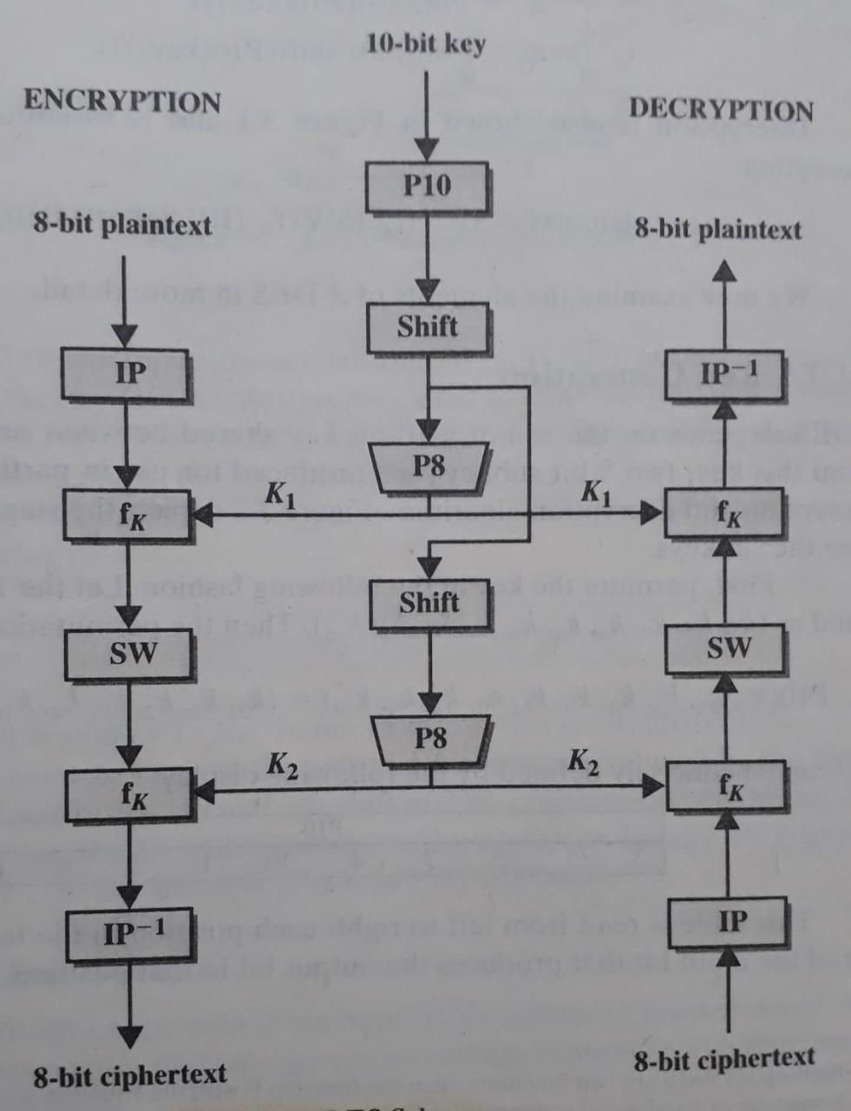
S-DES Scheme (1/2)

Slide 5
S-DES Scheme (2/2)
Ciphertext = IP⁻¹(f_{K2}(SW(f_{K1}(IP(Plaintext)))))
Plaintext = IP⁻¹(f_{K1}(SW(f_{K2}(IP(Ciphertext)))))
Where
K1 = P8(Shift(P10(Key)))
K2 = P8(Shift(Shift(P10(Key))))

Slide 6
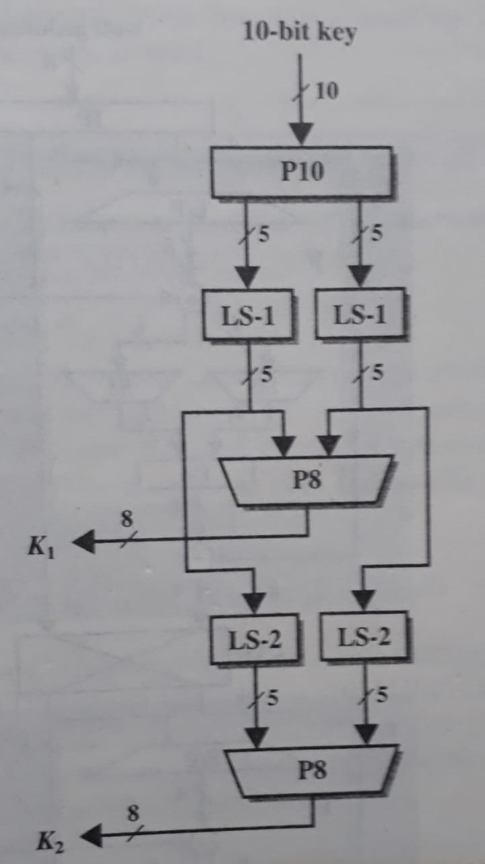
S-DES Key Generation
Permutations
Let, the 10-bit key is (k₁, k₂, k₃, k₄, k₅, k₆, k₇, k₈, k₉, k₁₀).
Then the permutation P10 is defined as P10(k₁, k₂, k₃, k₄, k₅, k₆, k₇, k₈, k₉, k₁₀) = (k₃, k₅, k₂, k₇, k₄, k₁₀, k₁, k₉, k₈, k₆).
Concisely P10 can be written as
Similarly P8 can be written as
Example
Key = ( 1 0 1 0 0 0 0 0 1 0 )
P10 ( 1 0 1 0 0 0 0 0 1 0 )
= ( 1 0 0 0 0 0 1 1 0 0 )
( 0 0 0 0 1 1 1 0 0 0 )
P8 ( 0 0 0 0 1 1 1 0 0 0 )
= ( 1 0 1 0 0 1 0 0 )
= K1
( 0 0 1 0 0 0 0 0 1 1 )
P8 ( 0 0 1 0 0 0 0 0 1 1 )
= ( 0 1 0 0 0 0 1 1)
= K2
P10
3 5 2 7 4 10 1 9 8 6
P8
6 3 7 4 8 5 10 9

Slide 7
Initial (IP) and Final (IP⁻¹) Permutations
Input to the IP is the 8-bit block of plain text
IP⁻¹(IP(X)) = X
IP
2 6 3 1 4 8 5 7
IP⁻¹
4 1 3 5 7 2 8 6

Slide 8
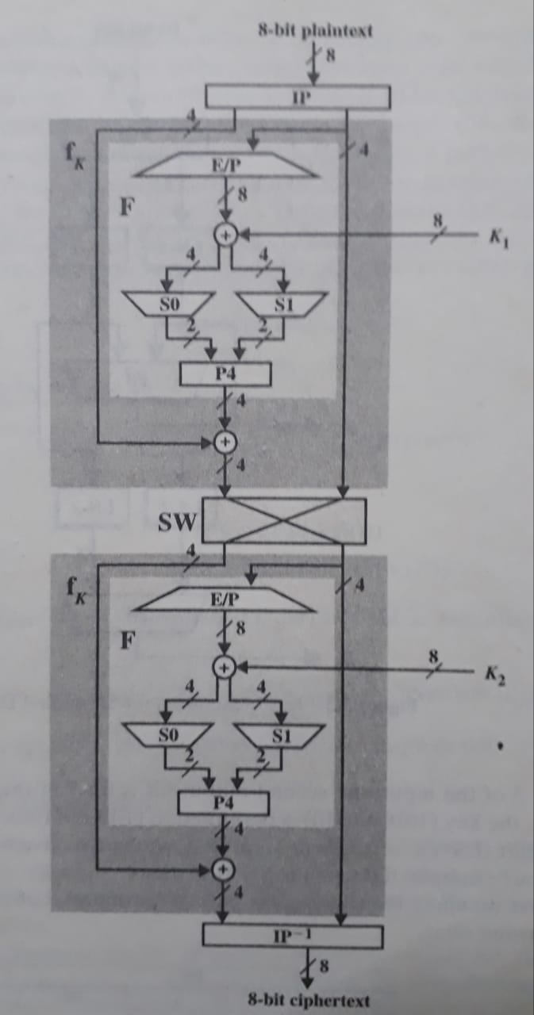
The Function f_{K}
f_{K} is a combination of permutation and substitution functions.
Let L and R be the leftmost 4 bits and right most 4 bits of the input to f_{K}, and let F be a mapping from 4-bit strings to 4-bit strings. Then we let
f_{K} ( L, R ) = ( L F ( R, SK ), R )
where SK is a sub-key and is the bit-
by-bit exclusive-OR function.
Example: Let the output of IP is (10111101) (i.e., L=(1011) and R=(1101)) and F ( R, SK ) = (1110) for the key SK. Then L F ( R, SK ) = (0101) and finally fK (1011, 1101) = (0101, 1101)

Slide 9
The Mapping F (1/4)
The input is a 4-bit number (n₁ n₂ n₃ n₄).
The first operation is an expansion/permutation operation.
We can depict this in other fashion:
n₄ n₁ n₂ n₃
n₂ n₃ n₄ n₁
E/P
4 1 2 3 2 3 4 1

Slide 10


The Mapping F (2/4)
The 8-bit sub-key K1 = (k₁₁, k₁₂, k₁₃, ……….. k₁₈) is added to the outcome of E/P using exclusive-OR:
Let us rename these 8-bits as follows:
First 4 bits (first row) is fed into S-box S0 to produce a 2-bit output, and the remaining 4 bits (second row) are fed into S1 to produce another 2-bit output.

Slide 11
The Mapping F (3/4)
The S-box S0 and S1 are defined as follows:
S0 = S1 =
The first and fourth input bits are treated as a 2-bit number that specify a row of the S-box, and the second and third input bits specify a column of the S-box. The entry in that row and column, in base 2, is the 2-bit output.
 | 0 | 1 | 2 | 3
0 | 1 | 0 | 3 | 2
1 | 3 | 2 | 1 | 0
2 | 0 | 2 | 1 | 3
3 | 3 | 1 | 3 | 2
 | 0 | 1 | 2 | 3
0 | 0 | 1 | 2 | 3
1 | 2 | 0 | 1 | 3
2 | 3 | 0 | 1 | 0
3 | 2 | 1 | 0 | 3

Slide 12
The Mapping F (4/4)
Example of S-box Operation:
If (P_{0,0} P_{0,3}) = (0 0) and (P_{0,1} P_{0,2}) = (1 0), then the output is from row 0 and column 2 of S0, which is 3, or (1 1) in binary. Similarly, (P_{1,0} P_{1,3}) and (P_{1,1} P_{1,2}) are used to index into a row and column of S1 to produce an additional 2 bits.
P4 Permutation:
The output of P4 is the output of F.
P4
2 4 3 1

Slide 13
The Switch Function
The switch function interchanges the left and right 4 bits so that the second instance of f_{K} operates on a different 4 bits.

Slide 14
Next Topic
Data Encryption Standard
(DES)

Slide 15
Thank you
Notes:
Is your presentation as crisp as possible? Consider moving extra content to the appendix.
Use appendix slides to store content that you might want to refer to during the Question slide or that may be useful for attendees to investigate deeper in the future.

